Slide 1

MATH6119: Analytical Consultancy Skills
Group Coursework
Heuristic Optimization of PCB Pick-and-Place Scheduling
Group 5 37569597, 36938912, 37652435, 36842427, 37218557, 36945811

Slide 2
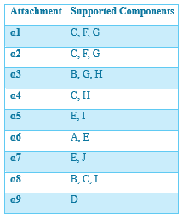
Problem Description
PCB conveyor system with 3 pick-and-place machines
Each machine has 3 attachment heads
PCB contains 10 component types (A–J)
Total 102 PCB placement locations
Objective:
Minimise travel distance
Balance machine workload
Satisfy all attachment constraints
Problem type:
Combinatorial optimisation problem
Related to TSP & VRP

Slide 3
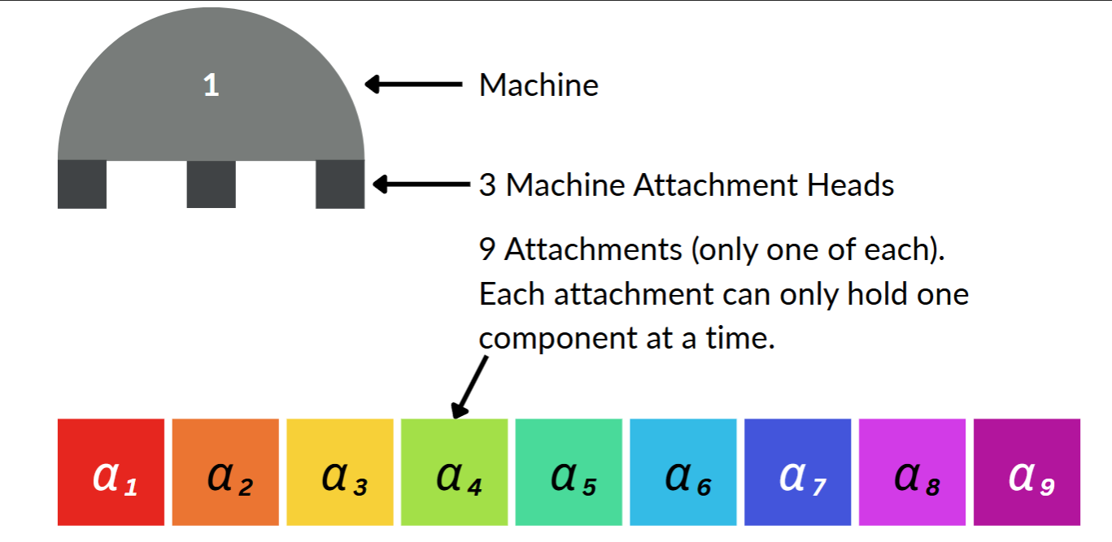

System Constraints
Machine constraints:
3 machines operate independently
Each machine has exactly 3 heads
Each head supports specific components
Key constraint rules:
Each attachment used once only
No overlap of attachments
PICK order fixed
PLACE order flexible
Distance model:
Comparison Permutation
Unoptimized path
(0,0) → (4,4) → (1,0) → (2,3) → (2,0)
Optimized Path
(0,0) → (1,0) → (2,0) → (4,1) → (4,4) → (2,3)

Slide 4
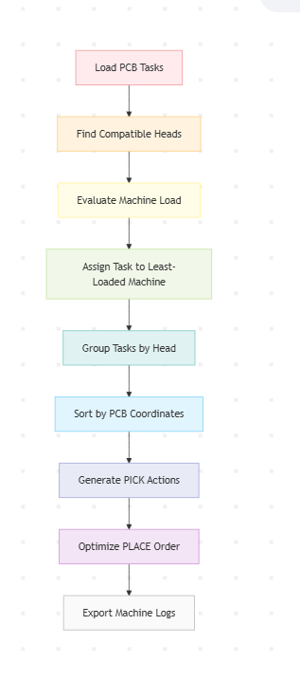
Workflow Pipeline
Heuristic approach:
Workload balancing
Coordinate-based sorting
Feeder-aware scheduling
Batch pick-and-place
Dynamic placement sequencing
Pipeline:
Input validation
Head assignment
Task allocation
Scheduling optimization
Output generation
Validation

Slide 5
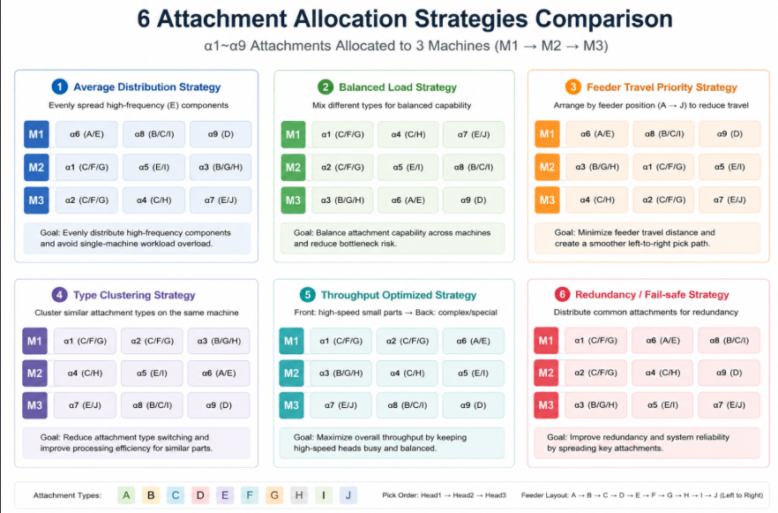
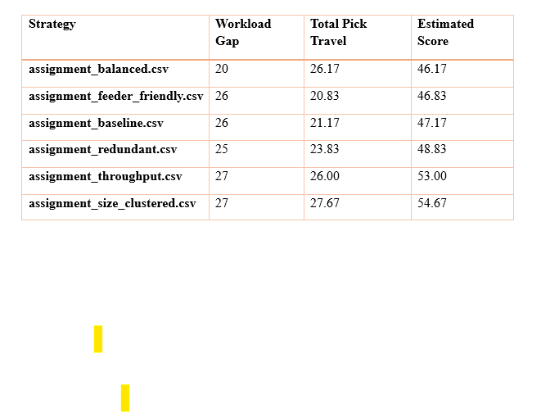

Strategy Evaluation

Slide 6
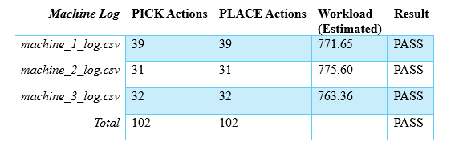
Conclusion
Machine Log Validation
Validation results:
102/102 placements completed
Required CSV structure satisfied
Valid PICK / PLACE action types used
Generated workplans passed output validation
Conclusion:
Balanced strategy achieved the lowest heuristic estimated score
Generated workplans passed CSV structure and PLACE-count validation
Feasible heuristic PCB scheduling system achieved

Slide 7
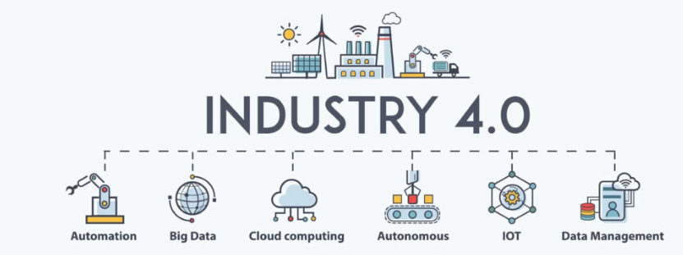
Applications
This system can be applied to:
Automated PCB assembly lines in electronics manufacturing
Smart factory production systems (Industry 4.0)
Multi-robot task scheduling systems
General industrial routing and scheduling optimization problems
Advantages of the Proposed System
✔ Reduces unnecessary machine travel distance
✔ Improves workload balance across machines
✔ Ensures constraint-compliant scheduling
✔ Scalable to larger PCB layouts

Slide 8
The End

